Slide 1


CSE-3200 SHOPIROUND (An application to find products nearby)
Supervisor
Abdul Aziz
Assistant Professor
Dept. of Computer Science and Engineering
Presented By
Akik Ashraf Rafi
1907009
Md. Mubtashim Abrar Nihal
1907010

Slide 2
Outlines
Introduction
Problem Statement
Related Applications
Objectives
Features
Outcomes and Impacts
System Architecture
System Implementation
User Interface
Future Works
Conclusion
References

Slide 3

Introduction
ShopiR und
Offline Shopping Platform
Improves traditional shopping experience
Shows local shops and their products with their distance
Connecting customers with local shopkeepers
Android WebView App
Figure 1: ShopiRound Logo

Slide 4

Problem Statement
User visits from shop to shop in search of products.
One in a new area doesn’t know where to buy goods.
Online shopping platforms provide online services only.
Figure 2: Local Market

Slide 5
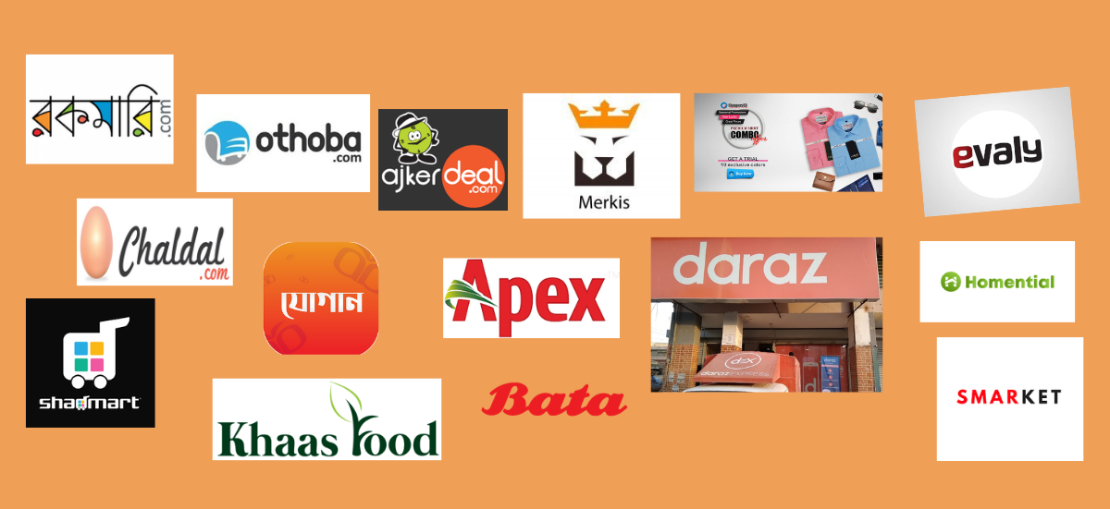
Related Applications
Daraz
Ajker Deal
Rokomari.com
Pickaboo
Chaldal.com
Etc.
Figure 3: Online Shopping Platforms

Slide 6
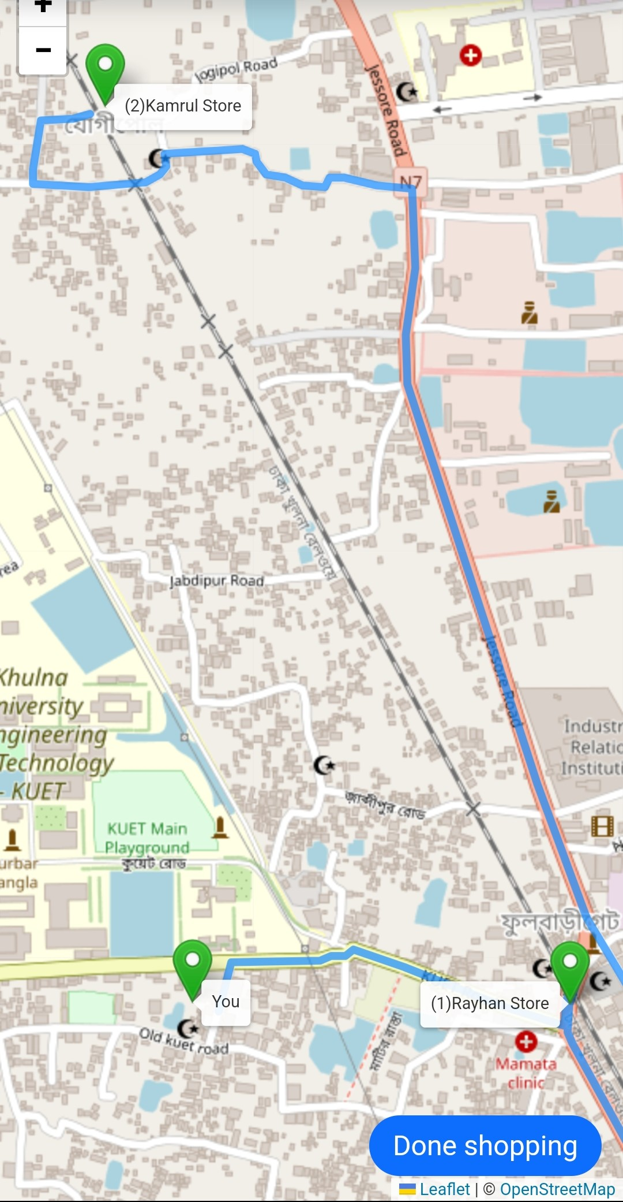
Objectives
Being aware of the local shops and their products
Find product in the local shop
Help buying product from closest shop
Help saving time, money & energy
Boost seller’s business
Figure 4: Routing Between
Customer and shops

Slide 7
Features
Search & Show product with distance
Show local shop location on map
Optimal path for minimal travelling from shop to shop
Estimates total distance to travel to shop

Slide 8
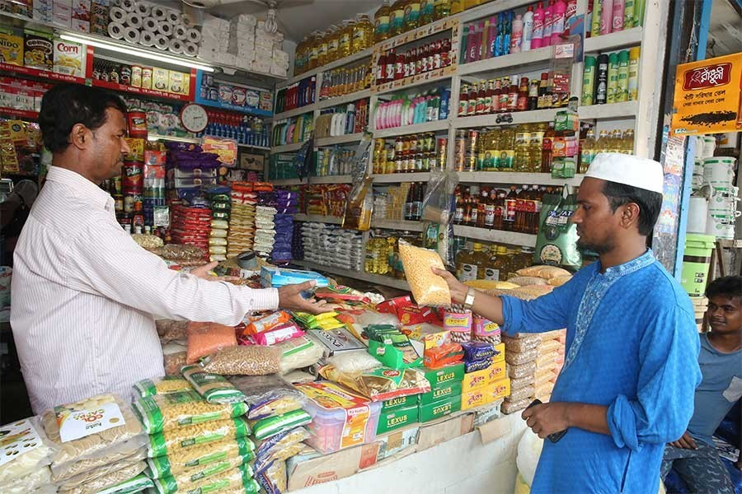
Outcomes and Impacts
Convenience and Time Saving
Enhanced Access to Goods
Communication Engagement
Health and Safety consideration
Environmental Impact
Figure 5: Shopkeeper customer Interaction

Slide 9
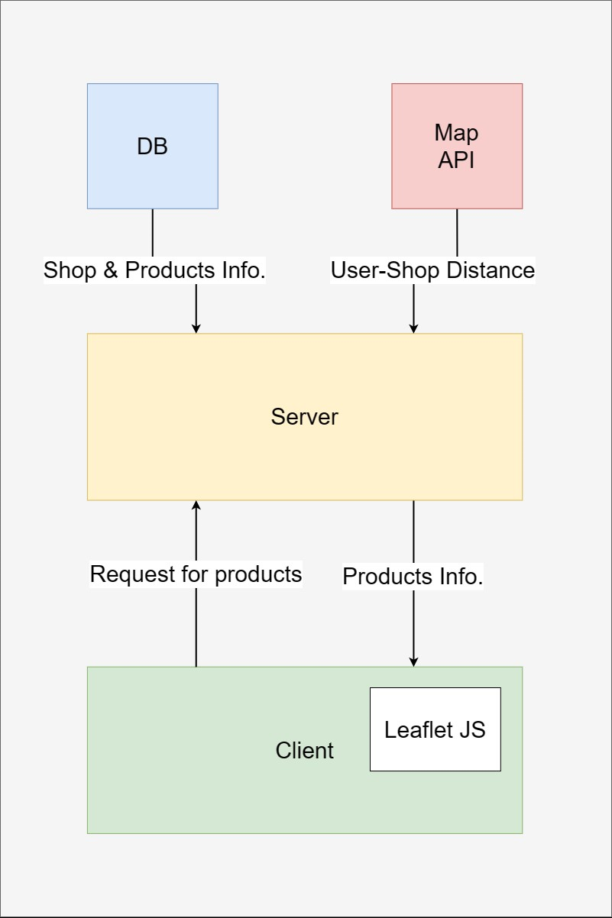
System Architecture
Product Catalog
Fetch all shops information with products
Determine user to shop distance
Show all products with distance
Figure 5: Product Catalog

Slide 10
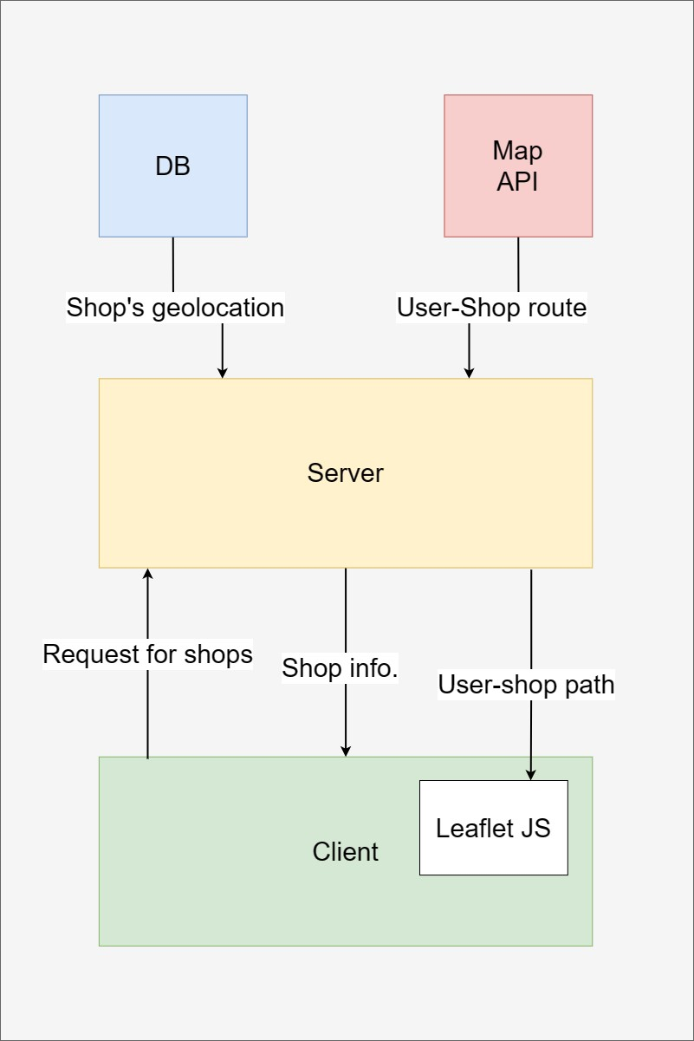
System Architecture(cont’d)
Shops Location
Fetch shop’s geolocation
Show shops location in Leaflet JS
Figure 6: Optimal Routing

Slide 11
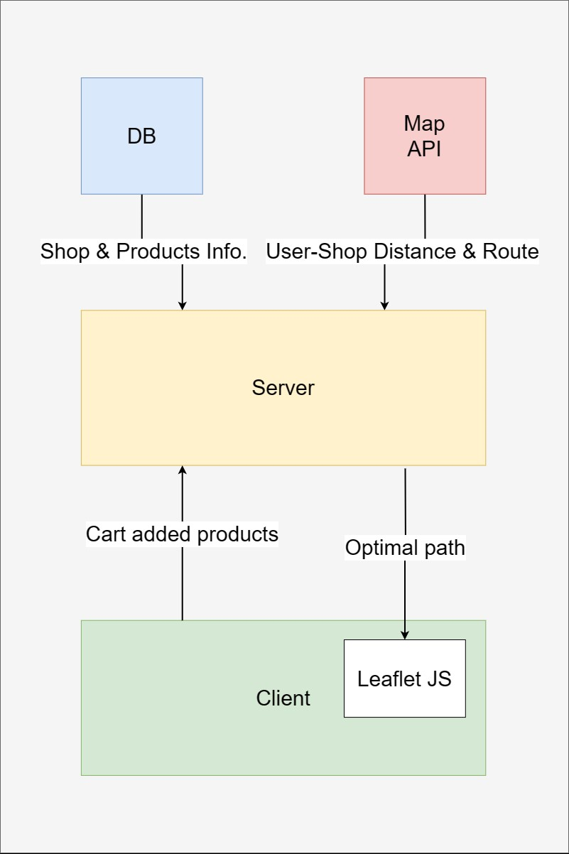
System Architecture(cont’d)
Offline Shopping
Store added product info to database
Fetch user and all shop’s location using Geoapify
Find optimal route
Show route with estimated distance
Figure 7: Optimal Routing

Slide 12
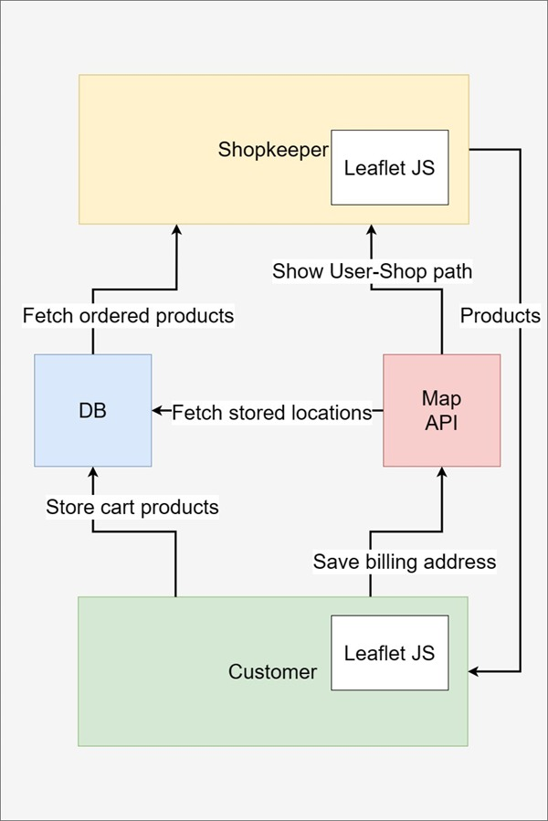
System Architecture(cont’d)
Online Shopping
Customer End
Store added product to database
Upon place order, notify shopkeeper
Shopkeeper End
Fetch all products ordered
Fetch user information including location
Deliver products and update the database
Figure 9: Optimal Routing

Slide 13
System Architecture(cont’d)
Shop Management
Add Product
Store product information to database
Update Product
Update product information to database
Monitor Statistics
Trending products and keywords

Slide 14
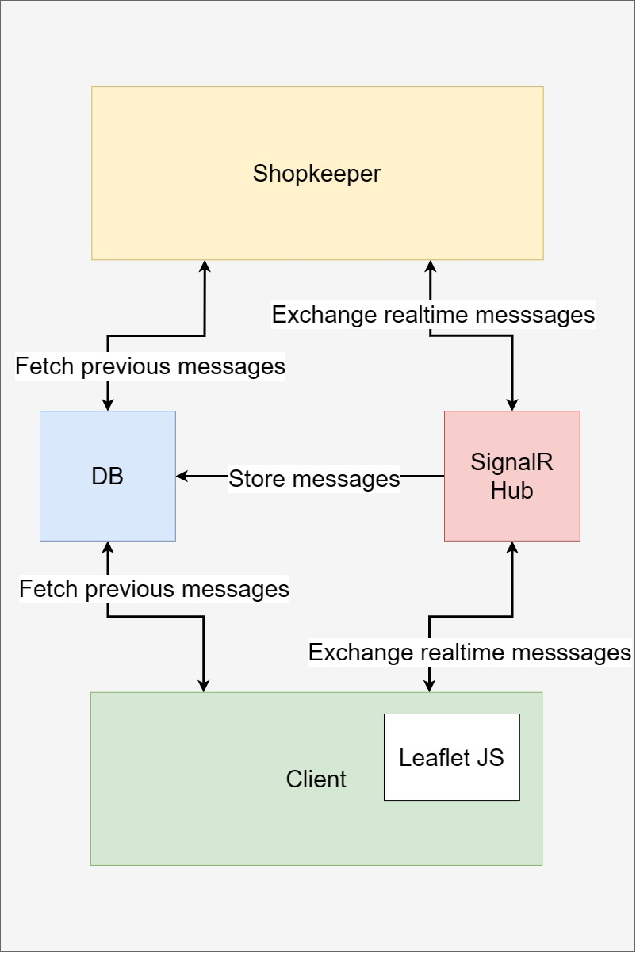
System Architecture(cont’d)
Chatting
Uses framework for Realtime communication
Messages are stored in database
Figure 10: Chatting System

Slide 15
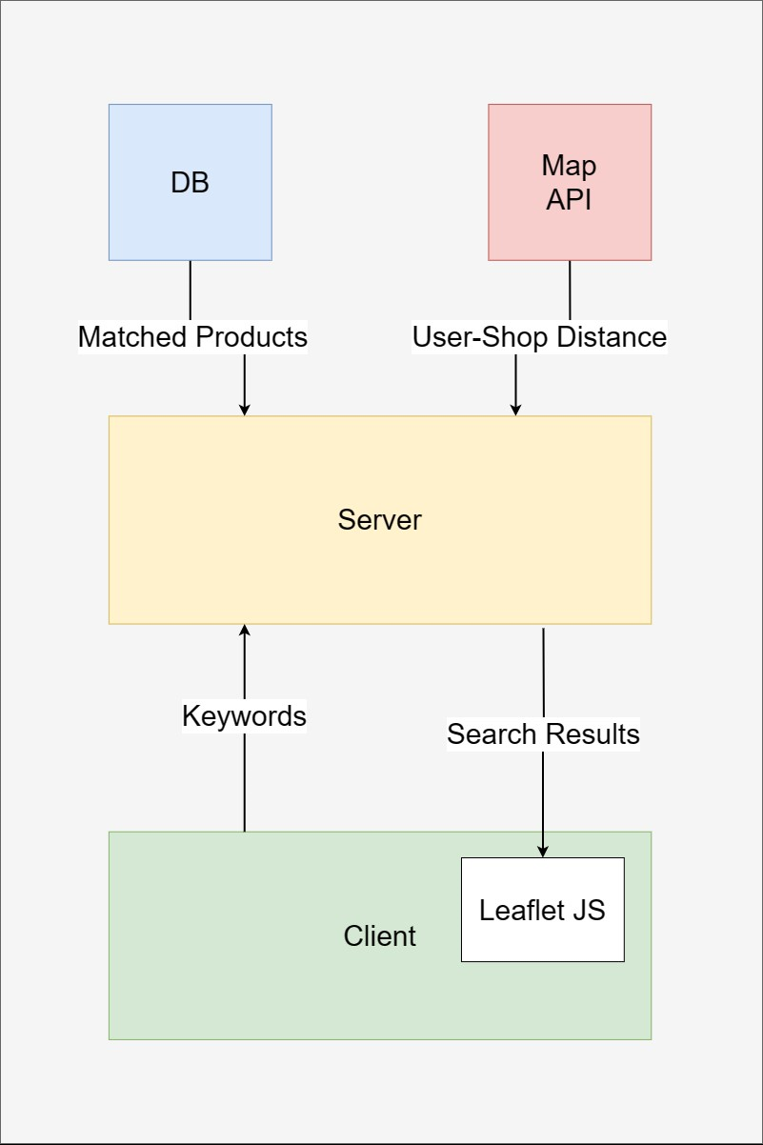
System Architecture(cont’d)
Search
Send keyword to server
Find all matched products with name or category
Send products to the client end
Figure 11: Search Functionality

Slide 16
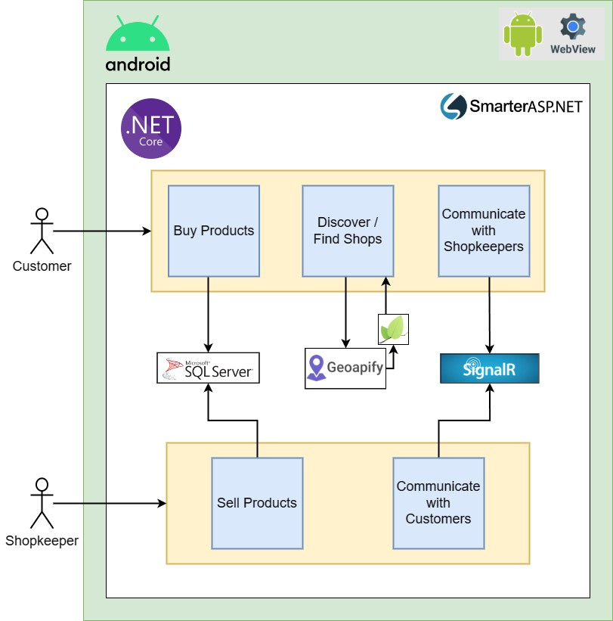
System Implementation
Backend: ASP.NET Core
Frontend: HTML, CSS, JavaScript, Leaflet.js
Database: Microsoft SQL Server (MS SQL)
Map API: Geoapify
Realtime Communication: SignalR
Figure 12: System Implementation Diagram

Slide 17
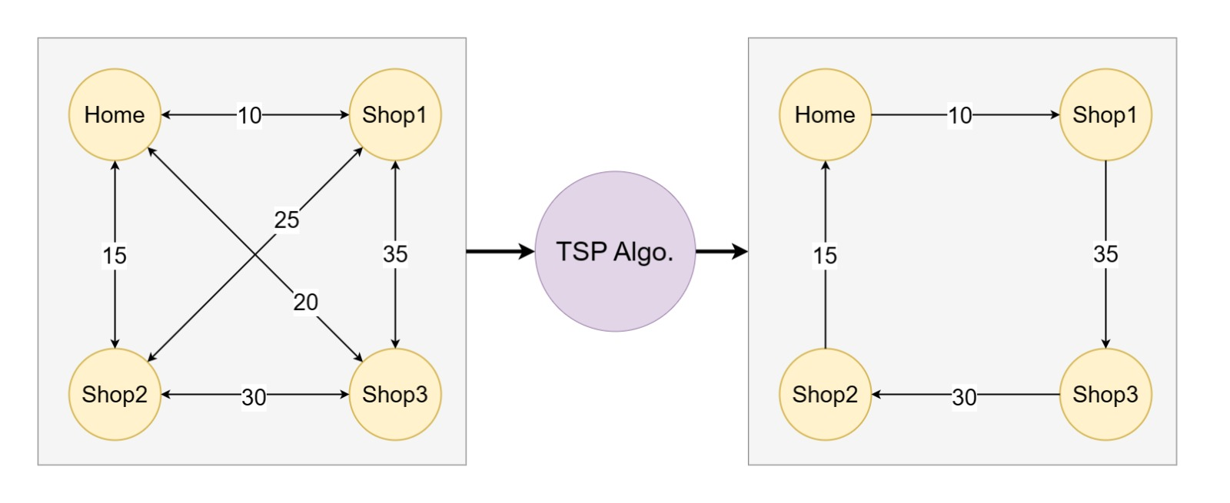
System Implementation(cont’d)
Optimal Routing
Fetch routing matrix using a map api
Apply TSP algorithm to find optimal path
Show optimal path on Leaflet JS
Figure 8: Optimal Routing using TSP

Slide 18
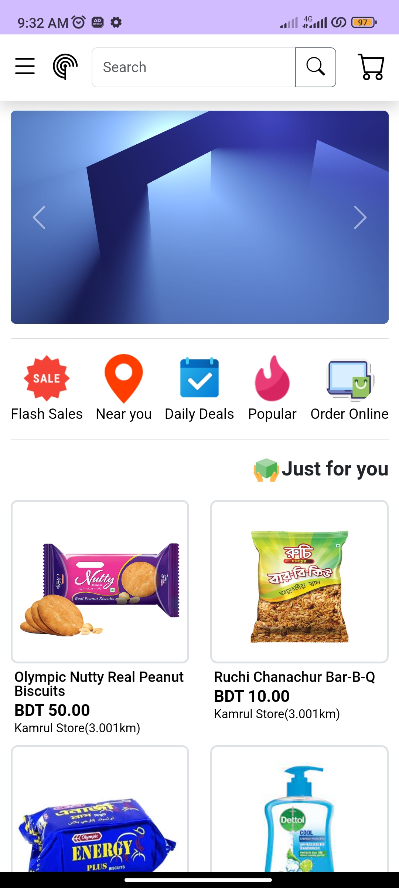
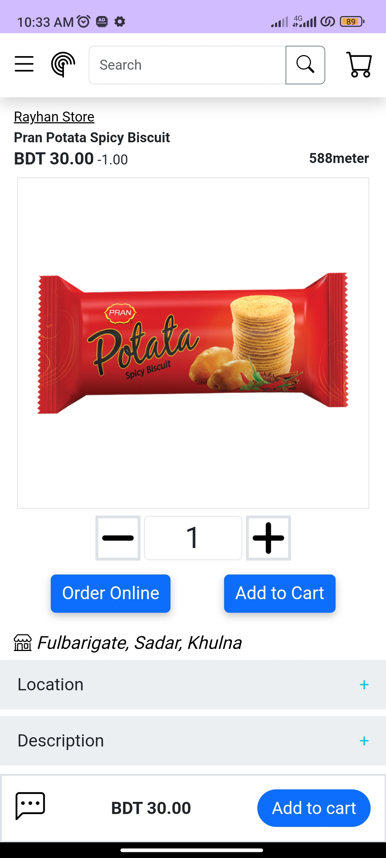
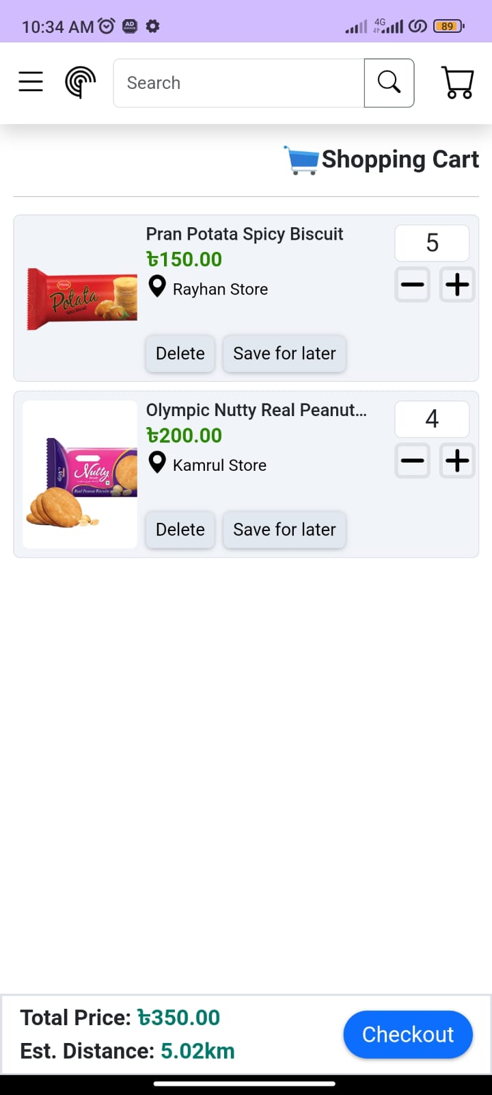
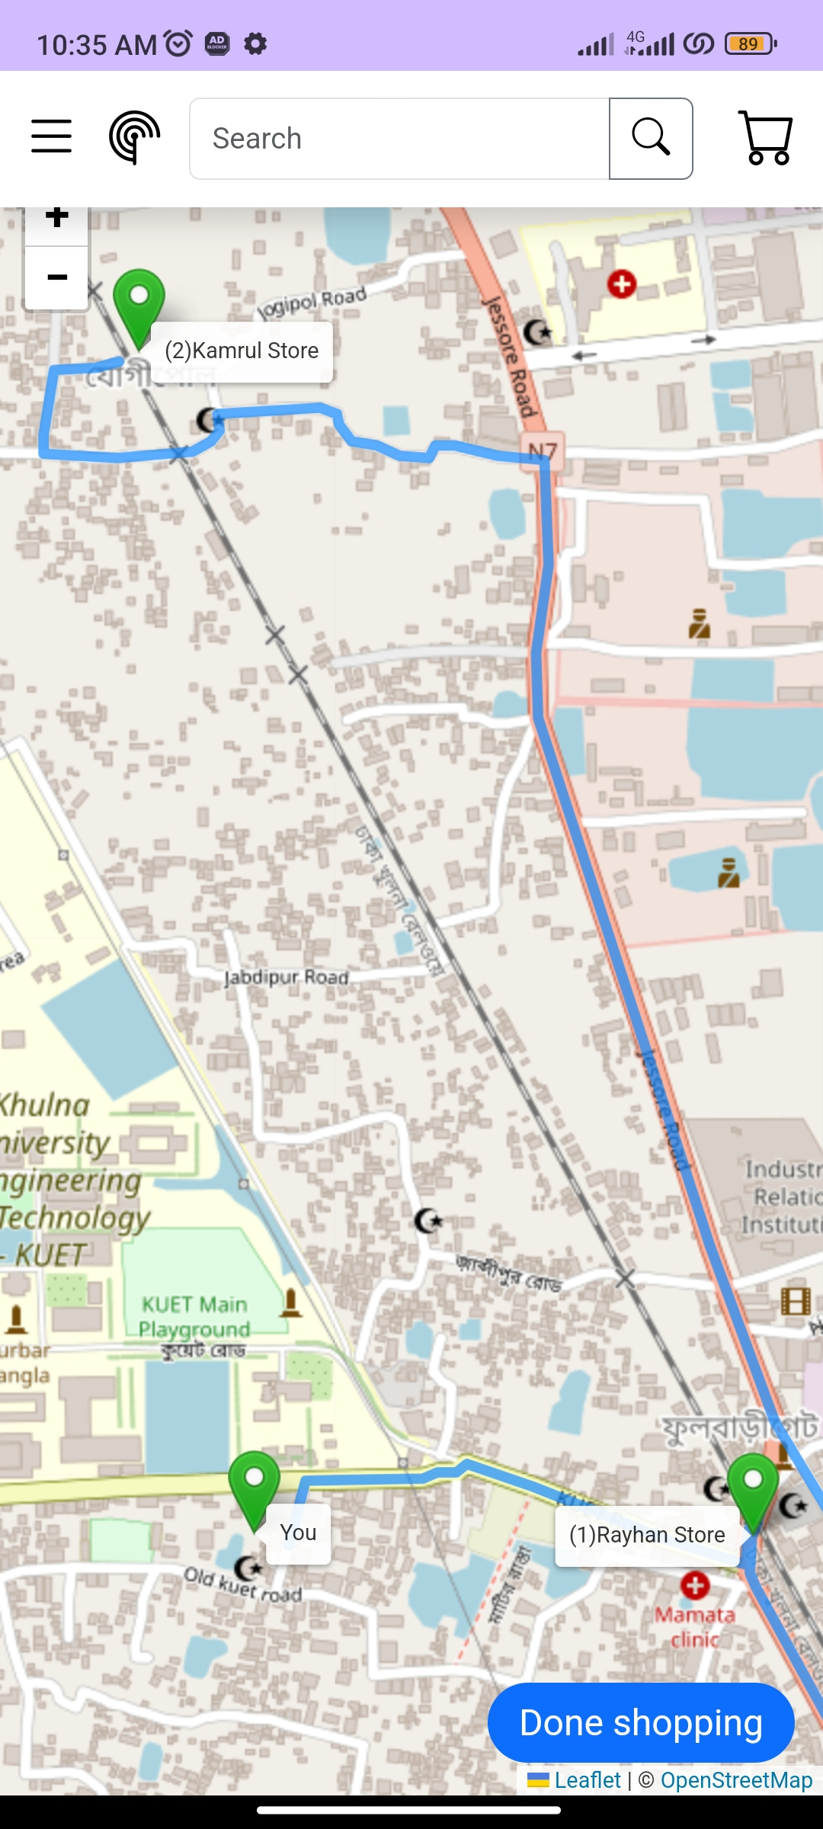
User Interface
Home
Product
Cart
Optimal Routing
toward Shops

Slide 19

Future Works
Enhance User Experience
Expansion and Scaling
Innovation and technology integration

Slide 20

Conclusion
Built with an aim to ease life a bit
Technical Challenges
Data Privacy and Security Challenges

Slide 21
References
[1] Daraz, Online shopping platform, https://www.daraz.com.bd/ (Last access: 30 November 2023)
[2] Rokomari, Online book selling platform, https://www.rokomari.com/book (Last access: 30 November 2023)
[3] Pickaboo, Online gadget selling platform, https://www.pickaboo.com/ (Last access: 30 November 2023)
[4] Chaldal, Online grocery selling platform https://chaldal.com/ (Last access: 29 November 2023) [5] Ajkerdeal, Online e-commerce platfrom, https://www.ajkerdeal.com/ (Last access: 29 November 2023)
[6] ASP.NET MVC, Web application framework, https://learn.microsoft.com/en-us/aspnet/mvc/ (Last access: 28 November 2023)
[7] Geoapify, Map and routing API, https://apidocs.geoapify.com/ (Last access: 28 November 2023)
[8] SignalR, Real time communication framework, https://dotnet.microsoft.com/en-us/apps/aspnet/signalr (Last access: 28 November 2023)
[9] Android Studio, Android Software Development Kit, https://developer.android.com/docs (Last access: 28 November 2023)
[10] SmarterASP– Free ASP.NET hosting website, https://www.smarterasp.net/ (Last access: 28 November 2023)

Slide 22
Thank You

